Slide 1
Activity 03: Modeling & Forecasting
SISMID Lab
July 22 through July 24, 2026
A Human – AI Teaming Approach to Infectious Disease Modeling

Slide 2

General Housekeeping
Any slide with this icon contains the goals and
expected outputs for the activity. All outputs listed in
the tables on these slides should be uploaded to the
course GitHub repository for review.
Any slide with this icon indicates that it is time to complete a hands-on activity. Carefully follow the instructions provided, complete the required task, and verify your results.

Slide 3
Lab Timeline
We are here
Activity 1
Activity 2
Activity 3
Activity 4
Data
Cleaning
Exploration
Modeling & Forecasting
Evaluation
Activity 5 Incremental Revisions

Slide 4
Activity Roadmap
The steps we will work through to fit the model and produce forecasts.
1
2
3
4
Write the Rules
Build the Agent
Generate the Script
Run & Commit
Add a Forecasting section to our rules document with precise rules for Task 0 through Task 5.
Regenerate agents.md from your updated rules so the agent follows your new instructions.
Use agents.md to have Copilot write the scripts/03_forecast.R script.
Run it, check the figure and flusight_forecasts.csv, then commit your results to GitHub.
Vague rules = vague output. Be precise about every detail.

Slide 5
Amanda, perhaps we create a slide here to detail the joint “instructor-class” free flow exercise

Slide 6
Amanda, Outline the 5 tasks here

Slide 7
Your Task
We will write forecasting rules for the six tasks (rules.md), then use them to generate the agent, the 03_forecast.R script, forecast file (CSV) and figure.
Activity Output | Description
rules.md | Forecasting rules for Tasks 0 - 5 — model details, forecasting, data & figure format.
agents.md | Regenerated from your updated rules so the agent follows your new instructions.
scripts/03_forecast.R | The R code Copilot (or AI of your choosing) writes from the agent to build the figure and forecast file.
figure + flusight_forecasts.csv | The finished outputs: forecast_vs_observed.png and flusight_forecasts.csv.

Slide 8
Task 0: Set-Up
Notes:
We Provide

Slide 9
# Forecasting
We first need to put rule(s) in place to create and save the R script. As this is an important piece to set-up the rest of what we will do for this activity, this code will sit at the very top of our rules. Add this rule under the # Forecasting header:
Save all code in this section to the following output script:
**Output folder:** `output/scripts/03_forecast.R`
The output folder may not yet exist in your working directory; we can put a rule in place to guard against this:
If the folder pathway is not present, create the folder pathway prior to saving the script.

Slide 10
## 1.Input Data
Next, we need to provide details related to what data we want to work with throughout the script (i.e., data we created in the previous activities).
To do so, all we need to do is give the AI the file path to the data. This ensures that the exact file we want is used as the remainder of the script is created.
First, add the 1. Input Data header under # Forecasting. Then, copy over the following rule:
Read in the input data set from `output/data/01_cleaning/cleaned_flu_admissions.csv`.

Slide 11
Input Data Validations
AI is not perfect by any means, so we want to build in some validations and error messages to help us catch any mistakes that might occur (e.g., file structure, parsing issues, etc.).
Under the input rule, include the following validations rules:
Ensure the column names and column types/formats match the following:
- `week`: Date column, YYYY-MM-DD
- `location`: Character; all values should be "US"
- `value`: Numeric
If any columns have violations please first try to parse to the correct format, and then notify the user. If any columns can not be parsed, please return the following error:
'The {column} could not be parsed.'

Slide 12
Insert slide
We need some sort of transition slide into “What is a Season”
Why are we defining this here? This is not intuitive.
Is this really necessary here? Or can this be worked into the training/test period?

Slide 13
Key Definition: What Is a "Season"?
We'll need this definition in the rules, so the agent knows how to identify season boundaries.
Influenza Season Boundaries
Time span: MMWR week 40 (≈ early October) through week 20 (≈ mid-May) of the next year. A season spans two calendar years and is named for both — e.g. 2025–26.
Season start: First calendar date of first year with Epiweek = 40. This is a fixed calendar week, the same every season, so the agent sets it directly rather than detecting it from the data. Please account for any leap years in this determination.
Season end: Earliest calendar date in the second year with Epiweek = 20.
(CDC, Purpose & Methods, 2025)
Notes:
CDC. (2025, December 2). U.S. Influenza Surveillance: Purpose and Methods. FluView. https://www.cdc.gov/fluview/overview/index.html
- Current Season: `2025-26`
- Season Start: first calendar date in the first year with epiweek == 40. This is a fixed calendar week and should be the same every season. Please account for any leap years in this determination as well.
- Season End: earliest calendar date in the second year with epiweek == 20.

Slide 14
Implementation Note
When computing `season_start_year` for each `week`, use the calendar year of the date (`year(week)`) as the base year passed to the assignment logic — do not use the `MMWRyear` returned by `MMWRweek()` as the
base. This avoids mis-attribution when MMWR week numbers span calendar-year boundaries.
Hint: When specifying the season definition in the rules, copy-and- paste this directly in with the other specifications (previous slide).

Slide 15
Now it’s your turn!
On your own, add the seasonality rules under ## 1. Input Data. If you get stuck, refer to the rules we added during the previous activity (Hint: nothing has changed)
1
Create the ## 2. Season Rules section header in rules.md.
Referring to the past two slides and previous activities, write the rules to define a season for this activity. Including the implementation note on the previous slide is CRITICAL to prevent date parsing errors as we work through the remainder of this activity.
2
Regenerate agents.md from your updated rules document. Use the agents.md file and Copilot (or AI of your choosing) to generate scripts/03_forecast.R. Run the script and check the output.
3

Slide 16
Task 1: Specifying the Training and Forecast Period

Slide 17
The Plan: Train & Testing Periods
TRAIN PERIOD
Seasons before 2025-2026
Fit the model on all observed weeks strictly before the first week of the testing period present in the data. Use these rows as the fixed initial training set; subsequent forecasts will use an ‘expanding window’.
TESTING PERIOD (Rolling)
2025-2026 Season
Use the defined 2025-2026 season (See Previous Slides) as the testing period.
Forecasting Horizon: 1-Week Ahead (horizon = 1)
Notes:
## 3. Training and Testing Periods
- `Training Period`: all observed weeks strictly before the first week of the testing period present in the data. Use these rows as the fixed initial training set; subsequent forecasts use an expanding window that adds earlier test-season weeks as they become observed.
- `Testing Period`: the `2025-26` season only.
- `Forecast Horizon`: 1 week ahead only (`horizon = 1`). Do not forecast any other horizon.
**`STRICT RULE`:** Forecasts are produced with an **expanding window**. For each
target week in the testing period, the model is refit on all observed weeks that
fall strictly before that target week. The initial training data is the set of
weeks strictly before the first testing-week present in the data; as each test
week becomes observed it is added to the fitting window for subsequent targets.
**`STRICT RULE`:** Only produce a forecast for a target week that is actually
present in the input data (so each forecast has an observed value to compare
against).
**Validations:** Print the `Training Period` start date, and rolling window end dates.
**Validations:** Print the `Testing Period` start date, and each forecast date.
**Validations:** Print the specified forecasting horizon that will be used.

Slide 18
Expanding Window
Forecasts are produced with an expanding window. For each target week in the testing period, the model is refit on all observed weeks that fall strictly before that target week. The initial training data is the set of weeks strictly before the first testing-week present in the data; as each test week becomes observed it is added to the fitting window for subsequent targets.
Notes:
Student Task: Add in the details

Slide 19
Adding in Diagnostics (a.k.a. Checks)
As we build this out, it's important that we include code checks along the way to ensure that things we specified in the rules.md are being interpreted by the AI as we intended.
Some Examples:
**Validations:** Print the `Training Period` start date and rolling window end dates.
**Validations:** Print the `Testing Period` start date, and each forecast date.
**Validations:** Print the specified forecasting horizon that will be used.
Notes:
**Validations:** Print the `Training Period` start date, and rolling window end dates.
**Validations:** Print the `Testing Period` start date, and each forecast date.
**Validations:** Print the specified forecasting horizon that will be used.

Slide 20
Now it’s your turn!
We will work through the following steps together to add the next section to our rules.md document.
1
Create the ## 3. Training and Testing Periods section header in rules.md.
Write detailed rules to specify the training and testing period information; including the ‘expanding window’ set up (we will do this together).
2
3
Regenerate agents.md from your updated rules document
4
Use the agents.md file and Copilot (or your preferred AI) to generate scripts/03_forecast.R. Run the script and check the output.

Slide 21
Task 2: Baseline Model Specification

Slide 22
Auto Regressive Integrated Moving Average (ARIMA)
A group of models that uses a time series' past values and past forecast errors to explain the current values of the series, with the goal of producing forecasts.
AR Model (p)
Uses the series' own recent values to predict what comes next
Integrated (d)
Used to make the time series stationary (stable over time), by subtracting the previous observation from the current one
MA Model (q)
Uses its own recent misses (how far off past predictions were) to predict what comes next
Assumes: The series is stationary after differencing (stable mean and variance over time).

Slide 23
Model Specification Rules

Slide 24
For the slide on the next page, let’s make sure we have a brief header to explain what we are looking at

Slide 25
 | Rule | Description
Package | forecast; forecast::auto.arima() | Use the auto.arima() function from the forecast package.
Response Variable | The influenza admissions series only. Sort the training window by `week`, extract the ordered value vector, and use that as the only input. No covariates or external regressors are permitted. | Use only the influenza admissions values. Put the training data in date order by `week`, pull out that ordered list of values, and feed only that to the model. Nothing else is added (i.e., no other variables or outside predictors).
Model Details | A non-seasonal ARIMA whose order is selected automatically by `auto.arima()`. The series is passed as a plain numeric vector, so `auto.arima()` performs its own `(p, d, q)` selection. | The model is a non-seasonal ARIMA, a standard forecasting method that predicts future values from the recent history of the series, without fitting a repeating yearly pattern. We hand auto.arima() just the plain list of counts and let it automatically choose the settings that fit the data best.
Notes:
## 4. Model Specification
- Package: **forecast** (`forecast::auto.arima()`).
- Response: the influenza admissions series **only.** Sort the training window by `week`, extract the ordered value vector (for example `y <- as.numeric(train_df$value)`), and fit `forecast::auto.arima(y)`. No covariates or external regressors are permitted.
- Model class: a non-seasonal ARIMA whose order is selected automatically by `auto.arima()`. The series is passed as a plain numeric vector, so `auto.arima()` performs its own `(p, d, q)` selection.
- The model is refit at every expanding-window step described in Rule 3.
Implementation note: `auto.arima()` on a bare numeric vector fits a **non-seasonal** ARIMA and relies on short-lag autocorrelation, so it will not capture the annual seasonal cycle — acceptable for a 1-week-ahead baseline. For a seasonal fit, pass `ts(y, frequency = 52)` or add Fourier terms via `xreg`; for non-negative, right-skewed counts, `lambda = "auto"` forecasts on a transformed scale. Both are optional and not required here.

Slide 26
Adding in Diagnostics (a.k.a. Checks)
As we build this out, it's important that we include code checks along the way to ensure that things we specified in the rules.md are being interpreted by the AI as we intended.
Some Examples:
**Validations:** Print confirmation that the training window is sorted ascending by `week` with no missing or duplicate weeks.
**Validations:** Print confirmation that the `week` index is evenly spaced (no skipped weeks); halt if this fails.
**Validations:** Print the `(p, d, q)` order that `auto.arima()` selected at each refit step.
Notes:
**Validations:** Print confirmation that the training window is sorted ascending by `week` with no missing or duplicate weeks.
**Validations:** Print confirmation that the `week` index is evenly spaced (no skipped weeks); halt if this fails.
**Validations:** Print the extracted response vector's length, and confirm it is numeric, non-negative, and free of `NA` values.
**Validations:** Print confirmation that the series is not constant before fitting.
**Validations:** Print the `(p, d, q)` order that `auto.arima()` selected at each refit step.
**Validations:** Print confirmation that the fit succeeded at each step (a non-null model was returned). ** Ask students for suggestions here

Slide 27
Now it’s your turn!
We will work through the following steps together to add the next section to our rules.md document.
1
Create the ## 4. Model Specification section header in rules.md.
Write detailed rules to fit the model using the expanding window approach and put the checks into place (we will do this together).
2
3
Regenerate agents.md from your updated rules document
4
Use the agents.md file and Copilot (or your preferred AI) to generate scripts/03_forecast.R. Run the script and check the output.

Slide 28
Task 3: Forecasting
Notes:
## 5. Forecast Generation
For each target week `t` in the testing period that is present in the data:
1. Compute the reference date as the calendar Date exactly one week before the target: `reference_date = as_date(t) - days(7)`. Use this Date for both training-window selection and for output. When writing CSVs, format `reference_date` and `target_end_date` as ISO dates (`YYYY-MM-DD`).
2. Fit the ARIMA model (Rule 4) on all rows with `week <= reference_date` (expanding-window).
3. Forecast one step ahead with `pr <- predict(fit, n.ahead = 1)`. Take the forecast mean from `pr$pred` and its standard error from `pr$se`.
4. Use the ARIMA forecast standard error **directly** as the 1-week-ahead predictive standard deviation: `sd_pred = as.numeric(pr$se)`. At horizon 1 this already incorporates the model's innovation variance, so do **not** add a separate residual-variance term (doing so double-counts the innovation variance and inflates the interval).
5. Compute the required quantiles from a normal predictive distribution:
`q_value = qnorm(p, mean = pred_mean, sd = sd_pred)`.
Quantiles to output (`output_type_id`): `0.025`, `0.5`, `0.975`.
- `0.5` = median (point forecast).
- `0.025` and `0.975` = lower/upper bounds of the **95% prediction interval**.
**`STRICT RULE`:** Clamp all forecast values at a floor of 0 (`pmax(value, 0)`)
and round to the nearest integer (admissions are non-negative counts).
**`STRICT RULE`:** Quantiles must be non-decreasing within each target week
(`0.025 <= 0.5 <= 0.975`); sort/enforce after clamping.

Slide 29
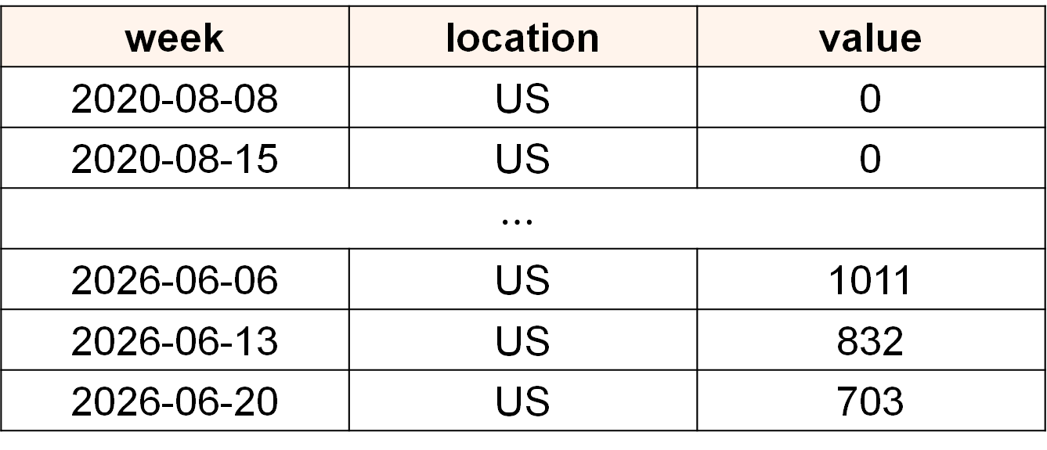
What does our data look like?
week | location | value
2020-08-08 | US | 0
2020-08-15 | US | 0
$$⋯$$
2026-06-06 | US | 1011
2026-06-13 | US | 832
2026-06-20 | US | 703
What are our reference dates (i.e., cut off for input data) and what are our target end dates (i.e., forecast dates)?

Slide 30
Reference Dates
Reference dates are the last week of observed data we include in our training period (i.e., model input). A week is defined as Sunday to Saturday, with the Saturday used for the label.
For example, if our most recent data is the week of 2026-06-20, that's our reference date, and we forecast the next week from it.
Observed Data
Horizon 1
2026-06-27
Horizon 2
2026-07-04
Horizon 3
2026-07-11
Reference Date
2026-06-20

Slide 31
Target End Dates
Target end dates are the weeks we are producing forecasts for. A week is defined as Sunday to Saturday, with the Saturday used for the label.
For example, if our reference date is 2026-06-20, our target end dates are 2026-06-27, 2026-07-04, and 2026-07-11 (the 1-, 2-, and 3-week-ahead forecasts).
Observed Data
Horizon 1
2026-06-27
Horizon 2
2026-07-04
Horizon 3
2026-07-11
Reference Date
2026-06-20
Target End Dates

Slide 32
Things to Consider
How do we calculate our reference date?
Hint: Compute the reference date as the calendar date exactly one week before the target date: reference_date = as_date(t) – days(7).
Where do we want to use the reference date specification?
Hint: Use this date (reference_date) for both training-window selection and for output.
How do we want to explicitly format our dates in the output?
Hint: When writing CSVs, format reference_date and target_end_date as ISO dates (`YYYY-MM-DD`).
Be explicit about dates. R can handle dates unpredictably; by being explicit we can stop issues and unexpected behavior before they happen.

Slide 33
Adding in Diagnostics (a.k.a. Checks)
Some Examples:
**Validations:** Print confirmation that reference_date and the target t are both Date objects (not character or POSIXct); halt if either fails the class check.
**Validations:** Print confirmation that target_end_date - reference_date equals exactly 7 days for every row; halt if this fails.
**Validations:** Print confirmation that the maximum week in the training window is <= reference_date and strictly less than the target_end_date (no look-ahead leakage); halt if this fails.
Notes:
Validations: Print confirmation that reference_date and the target t are both Date objects (not character or POSIXct); halt if either fails the class check. Validations: Print confirmation that target_end_date - reference_date equals exactly 7 days for every row; halt if this fails. Validations: Print confirmation that both reference_date and target_end_date fall on a Saturday (wday(x) == 7); halt if any date does not. Validations: Print confirmation that reference_date and target_end_date contain no NA values after computation; halt if any are present. Validations: Print confirmation that the maximum week in the training window is <= reference_date and strictly less than the target week (no look-ahead leakage); halt if this fails. Validations: Print confirmation that reference_date and target_end_date match the ISO pattern ^\d{4}-\d{2}-\d{2}$ as written to the CSV. ** Ask students for suggestions here

Slide 34
What is purpose of next section (Forecast generation)?
Based on some of this, may be best if we do this as a class?
For example, item 2 (detailed rules to handle dates) is a bit confusing

Slide 35
Now it’s your turn!
On your own, update your rules to include the date formatting requirements discussed on the previous slide. If you get stuck, pay particular attention to the hints provided on the previous slide(s).
1
Create the ## 5. Forecast Generation section header in rules.md and add the statement For each target week `t` in the testing period that is present in the data: under it.
Write detailed rules to specify how to handle dates in list item one (i.e., under the statement from Step 1; add 1. and your rules). As part of this step, add in validation checks.
2
3
Regenerate agents.md from your updated rules document.
4
Use the agents.md file and Copilot (or your preferred AI) to re-generate scripts/03_forecast.R. Run the script and check the output.
Notes:
## 5. Forecast Generation
For each target week `t` in the testing period that is present in the data:
1. Compute the reference date as the calendar Date exactly one week before the target: `reference_date = as_date(t) - days(7)`. Use this Date for both training-window selection and for output. When writing CSVs, format `reference_date` and `target_end_date` as ISO dates (`YYYY-MM-DD`).

Slide 36
What is the purpose of the next slide
Why wasn’t this just incorporated into the original rules for training/testing?
We should try not to come back to rules unless we are improving the model.

Slide 37
We have our date rules, now what?
Data leakage happens when a model is tested on data used in training (i.e., it "predicts" values it was handed, so the forecast is better than it it would be in practice when you don’t actually see the data).
To prevent this, we're explicit about the cutoff: only data on or before the reference date goes in as input, so the model never sees the weeks it's forecasting.
Add the following under the date rule(s):
2. Fit the ARIMA model (Rule 4) on all rows with `week <= reference_date` (expanding-window).
Notes:
Thinking this as a quick live-demo as we are going through slides.

Slide 38
Forecasting (1-Week Ahead)
output_type | output_type_id | value | Description
quantile | 0.025 | # | Lower Bound (95% PI)
quantile | 0.5 | # | Median
quantile | 0.975 | # | Upper Bound (95% PI)
How do we get the values?
3. Forecast with `forecast(fit, h = 1, level = 95)`.
Notes:
3. Forecast with `forecast(fit, h = 1, level = 95)`. Take the point forecast
(`mean`), lower bound, and upper bound; round each to 2 decimals and clamp
negatives to 0 (counts are non-negative).
4. Reshape to long — three rows for the week, one per quantile:
mean -> `0.5`, lower → c(`0.025`), upper → c(`0.975`). Tag the bound columns before
combining so the two `"95%"` names don't collide.
5. Attach the fixed §6 columns in order and bind across weeks.
- `0.5` = median = point forecast (mean = median: the untransformed Gaussian
predictive distribution is symmetric).
- `0.025` / `0.975` = the 95% prediction-interval bounds.
**`STRICT RULE`:** Clamp at 0 — applied in Rule 3.
**`STRICT RULE`:** Non-decreasing within each week — holds since lower ≤ mean ≤
upper by construction.
**`STRICT RULE`:** Exactly three rows per target week — one per quantile.

Slide 39
Extracting the Median & 95% PI Bounds
forecast(fit, h = 1, level = 95)
Lower Bound
(fcst$lower)
Point Forecast
(fcst$mean)
Upper Bound
(fcst$upper)
Things to think about when writing rules.
What pieces of information do we need to extract from the forecast call? What format will the data come back in (Hint: The lower and upper bounds come back with one column per level)? Are there any restrictions we want to place on the results (Hint: Rounding, Truncating at 0)?
Notes:
From the forecast object, pull three pieces: the point forecast, the lower bound, and the upper bound. The lower and upper bounds should come back with one column per level.

Slide 40
Adding in Diagnostics (a.k.a. Checks)
Some Examples:
**Validations:** Confirm mean, lower, and upper are all finite (no NA/NaN/Inf) at each forecast step; halt if not.
**Validations:** Confirm 0.025 ≤ 0.5 ≤ 0.975 (and generally, quantiles non-decreasing) within every target week. Halt on any violation.
**Validations:** Confirm all value entries are non-negative integers.
Notes:
** Ask students for suggestions here

Slide 41
Now it’s your turn!
On your own, add a rule for extracting the median and 95% PI Bounds. If you get stuck, pay particular attention to the hints provided on the previous slide.
1
Using the information from the previous slide, write the rule for extracting the median and 95% PI bounds from the forecast function (Rule 4). Make sure to include a statement about the output structure, any rules about results, and code checks (Hint: See previous slides).
2
Regenerate agents.md from your updated rules document.
3
Use the agents.md file and Copilot (or your preferred AI) to re-generate scripts/03_forecast.R. Run the script and check the output.
Notes:
From the forecast object, pull three pieces: the point forecast (fcst$mean), the lower bound (fcst$lower), and the upper bound (fcst$upper). The lower and upper bounds come back with one column per level.

Slide 42
Preparing File in FluSight Format
What is the FluSight format?

Slide 43
Column | Description | Entry Type | Acceptable Values
reference_date | The last day of the week the forecast(s) are submitted to the challenge. It is the Saturday following the forecast due date. | ISO Format Date | YYYY-MM-DD
target | The target of the forecast. | Character | wk inc flu hosp
horizon | The number of weeks between the reference_date and the target_end_date. | Numeric | [1]
target_end_date | The last date of the retrospective/nowcast/ forecast target’s week (Saturday). | ISO Format Date | YYYY-MM-DD
location | FIPS codes for U.S. states as well as "US" for national forecasts the corresponding row is associated with. | Character | US
output_type | The type of value shown. | Character | quantile
output_type_id | The quantile label for the value in the corresponding row. | Numeric | 0.01, 0.025, 0.05, 0.1, 0.15, 0.2, 0.25, 0.3, 0.35, 0.4, 0.45, 0.5, 0.55, 0.6, 0.65, 0.7, 0.75, 0.8, 0.85, 0.9, 0.95, 0.975, and 0.99
value | The non-negative numbers indicating the quantile prediction for the corresponding row. | Numeric | Integer

Slide 44
First, Handling the Quantiles (Wide-to-Long)
Our Current Format
0.025 | 0.5 | 0.975
VALUE | VALUE | VALUE
Our Goal Format
output_type_id | value
0.025 | #
0.5 | #
0.975 | #

Slide 45
How do we get there?
Add the following (Including the table):
4. **Reshape wide → long, one row per quantile.** Map each forecast piece to an `output_type_id`: `mean` → `0.5` (median); each level's lower/upper bound → its two quantiles, per the table. Only include the levels below.
Coverage Level | LB Quantile (`output_type_id`) | UB Quantile (`output_type_id`)
95 | 0.025 | 0.975

Slide 46
Why do we need the table?
forecast() and FluSight describe the same thing in two different languages. When you ask for a "95% interval," forecast() gives you a lower and an upper edge — those edges are the 0.025 and 0.975 quantiles that FluSight asks for. Think of the table as your & the AI’s translation guide between the two.
Hint (for later): Want more quantiles? Update two things together — add a row here (table) and set level in the forecast call to match. After that, everything downstream follows automatically.

Slide 47
Column | Description | Entry Type | Acceptable Values
reference_date | The last day of the week the forecast(s) are submitted to the challenge. It is the Saturday following the forecast due date. | ISO Format Date | YYYY-MM-DD
target | The target of the forecast. | Character | wk inc flu hosp
horizon | The number of weeks between the reference_date and the target_end_date. | Numeric | [1]
target_end_date | The last date of the retrospective/nowcast/ forecast target’s week (Saturday). | ISO Format Date | YYYY-MM-DD
location | FIPS codes for U.S. states as well as "US" for national forecasts the corresponding row is associated with. | Character | US
output_type | The type of value shown. | Character | quantile
output_type_id | The quantile label for the value in the corresponding row. | Numeric | 0.01, 0.025, 0.05, 0.1, 0.15, 0.2, 0.25, 0.3, 0.35, 0.4, 0.45, 0.5, 0.55, 0.6, 0.65, 0.7, 0.75, 0.8, 0.85, 0.9, 0.95, 0.975, and 0.99
value | The non-negative numbers indicating the quantile prediction for the corresponding row. | Numeric | Integer
We’ve gotten the output_type_id and value ready (previous slides), now we need to pull everything together into one data set!

Slide 48
Now it’s your turn!
On your own, add the rules for formatting the forecast in FluSight format and saving the file (Hint: look at the column names and descriptions provided on the previous slide).
1
Using a table format (see Reshape wide slide), create a table with the Column names and Type/Value for each field required for FluSight. Include this table as part of Rule 5. Use the table on the previous slide to guide you.
Save the file to output/data/03_forecast/flusight_forecasts.csv; create the folder if it is absent.
2
3
Regenerate agents.md from your updated rules document and use the agents.md file and Copilot (or your preferred AI) to re-generate scripts/03_forecast.R. Run the script and check the output.
Notes:
From the forecast object, pull three pieces: the point forecast (fcst$mean), the lower bound (fcst$lower), and the upper bound (fcst$upper). The lower and upper bounds come back with one column per level.

Slide 49
Task 4: Visualization
Notes:
## 5. Forecast Generation
For each target week `t` in the testing period that is present in the data:
1. Compute the reference date as the calendar Date exactly one week before the target: `reference_date = as_date(t) - days(7)`. Use this Date for both training-window selection and for output. When writing CSVs, format `reference_date` and `target_end_date` as ISO dates (`YYYY-MM-DD`).
2. Fit the ARIMA model (Rule 4) on all rows with `week <= reference_date` (expanding-window).
3. Forecast one step ahead with `pr <- predict(fit, n.ahead = 1)`. Take the forecast mean from `pr$pred` and its standard error from `pr$se`.
4. Use the ARIMA forecast standard error **directly** as the 1-week-ahead predictive standard deviation: `sd_pred = as.numeric(pr$se)`. At horizon 1 this already incorporates the model's innovation variance, so do **not** add a separate residual-variance term (doing so double-counts the innovation variance and inflates the interval).
5. Compute the required quantiles from a normal predictive distribution:
`q_value = qnorm(p, mean = pred_mean, sd = sd_pred)`.
Quantiles to output (`output_type_id`): `0.025`, `0.5`, `0.975`.
- `0.5` = median (point forecast).
- `0.025` and `0.975` = lower/upper bounds of the **95% prediction interval**.
**`STRICT RULE`:** Clamp all forecast values at a floor of 0 (`pmax(value, 0)`)
and round to the nearest integer (admissions are non-negative counts).
**`STRICT RULE`:** Quantiles must be non-decreasing within each target week
(`0.025 <= 0.5 <= 0.975`); sort/enforce after clamping.

Slide 50
Visualizing our Results
As a final step, we will visualize our results. A quick plot lets us catch any immediate issues (misaligned dates, wildly wide intervals, forecasts that ignore the trend) and get a feel for overall performance.
Remember, the rules for figures should be specific enough that someone (or an AI) could produce the plot without asking any follow-up questions.
We'll work together to build our final figure.
Notes:
## 6. Forecast Figure
Output the figure to:
`output/figures/03_forecast/forecast_vs_observed.png`
If the folder path is not present, create the folder prior to saving the image.
Image save requirements:
- 300 DPI
`Figure Specifications:`
- `Plot Type`: Line chart of observed `value` over the testing period
(`2025-26` season) with the 1-week-ahead forecast overlaid on the same axes.
- `Observed`: solid line plus points for observed weekly admissions.
- `Forecast Median`: line/points for the `0.5` quantile at each `target_end_date`.
- `Forecast Interval`: shaded ribbon spanning the `0.025`–`0.975` quantiles
(the 95% PI) at each `target_end_date`. The ribbon must sit **behind** the
observed and median lines.
- `X-Axis Label`: 'Week'
- `Y-Axis Label`: 'Weekly Influenza Hospitalizations'
- `Y-Axis Range/Tick Labels`: Start at 0 and max label at 10000 past the max
plotted value (whichever is larger: observed or the upper PI bound).
- `X-Axis Range/Tick Labels:` Use calendar dates from the first to last observed week in the 2025-26 testing period, with weekly spacing (7-day increments). Show every 4 date labels, and tilt labels 45 degrees.
- `Plot Title`: 'USA 1-Week-Ahead Influenza Hospitalization Forecast (2025-26 Season)';
Bold; Centered
- `Legend`: A single legend distinguishing **Observed**, **Forecast Median**,
and **95% PI**.

Slide 51
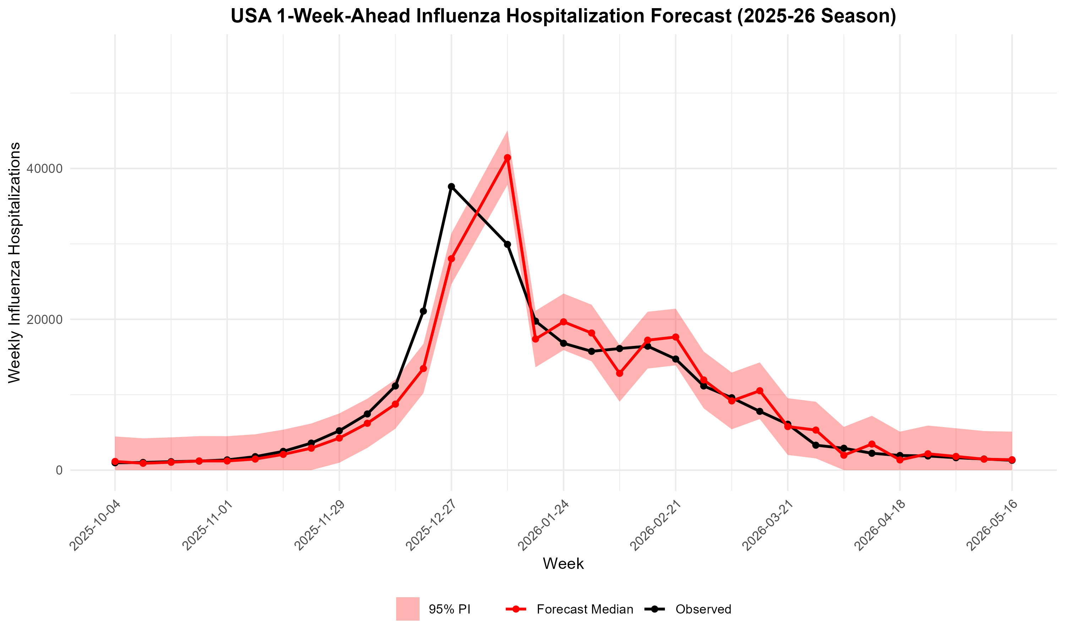

Slide 52
Writing the Visualization Rules
Things to think about:
Element | Description
Plot type & Plot Elements | line chart, bar chart, scatter, etc.
X-Axis and Y-Axis | variable, label text, date format, start at zero?
Title | exact title text for the figure
Colors and highlights | line color, shading, annotation colors
Annotations and markers | peak markers, reference lines, text labels
Legend | Legend elements, labels, colors
Output file name | output/figures/03_forecast/forecast_vs_observed.png
Save Requirements | DPI
Notes:
## 6. Forecast Figure
Output the figure to:
`output/figures/03_forecast/forecast_vs_observed.png`
If the folder path is not present, create the folder prior to saving the image.
Image save requirements:
- 300 DPI
`Figure Specifications:`
- `Plot Type`: Line chart of observed `value` over the testing period
(`2025-26` season) with the 1-week-ahead forecast overlaid on the same axes.
- `Observed`: solid line plus points for observed weekly admissions.
- `Forecast Median`: line/points for the `0.5` quantile at each `target_end_date`.
- `Forecast Interval`: shaded ribbon spanning the `0.025`–`0.975` quantiles
(the 95% PI) at each `target_end_date`. The ribbon must sit **behind** the
observed and median lines.
- `X-Axis Label`: 'Week'
- `Y-Axis Label`: 'Weekly Influenza Hospitalizations'
- `Y-Axis Range/Tick Labels`: Start at 0 and max label at 10000 past the max
plotted value (whichever is larger: observed or the upper PI bound).
- `X-Axis Range/Tick Labels:` Use calendar dates from the first to last observed week in the 2025-26 testing period, with weekly spacing (7-day increments). Show every 4 date labels, and tilt labels 45 degrees.
- `Plot Title`: 'USA 1-Week-Ahead Influenza Hospitalization Forecast (2025-26 Season)';
Bold; Centered
- `Legend`: A single legend distinguishing **Observed**, **Forecast Median**,
and **95% PI**.

Slide 53
Now it’s your turn!
We will work through the following steps together to add that next section to our rules.md document.
1
Create the ## 6. Forecast Figure section header under
## 5. Forecast Generation section header in rules.md.
Write detailed rules to obtain the forecast visual. Make sure to specify plot types, axes, colors, annotations, file names, etc. (vague rules = vague output).
2
3
Regenerate agents.md from your updated rules document
4
Use the agents.md file and Copilot (or your preferred AI) to update scripts/03_forecast.R. Run the script and check the output.

Slide 54
Task 5: Extensions
Notes:
## 5. Forecast Generation
For each target week `t` in the testing period that is present in the data:
1. Compute the reference date as the calendar Date exactly one week before the target: `reference_date = as_date(t) - days(7)`. Use this Date for both training-window selection and for output. When writing CSVs, format `reference_date` and `target_end_date` as ISO dates (`YYYY-MM-DD`).
2. Fit the ARIMA model (Rule 4) on all rows with `week <= reference_date` (expanding-window).
3. Forecast one step ahead with `pr <- predict(fit, n.ahead = 1)`. Take the forecast mean from `pr$pred` and its standard error from `pr$se`.
4. Use the ARIMA forecast standard error **directly** as the 1-week-ahead predictive standard deviation: `sd_pred = as.numeric(pr$se)`. At horizon 1 this already incorporates the model's innovation variance, so do **not** add a separate residual-variance term (doing so double-counts the innovation variance and inflates the interval).
5. Compute the required quantiles from a normal predictive distribution:
`q_value = qnorm(p, mean = pred_mean, sd = sd_pred)`.
Quantiles to output (`output_type_id`): `0.025`, `0.5`, `0.975`.
- `0.5` = median (point forecast).
- `0.025` and `0.975` = lower/upper bounds of the **95% prediction interval**.
**`STRICT RULE`:** Clamp all forecast values at a floor of 0 (`pmax(value, 0)`)
and round to the nearest integer (admissions are non-negative counts).
**`STRICT RULE`:** Quantiles must be non-decreasing within each target week
(`0.025 <= 0.5 <= 0.975`); sort/enforce after clamping.

Slide 55
Expanding to full FluSight Format
Our current forecasts do not capture all horizons and quantiles required by FluSight.
The remainder of this activity will focus on expanding our current framework to all 23 quantiles and forecasting horizons required by the challenge.
 | Current | Goal
Horizons | 1-Week | 1 Week - 3 Weeks
Quantiles | 0.025, 0.5, 0.975 | 0.01, 0.025, 0.05, 0.1, 0.15, 0.2, 0.25, 0.3, 0.35, 0.4, 0.45, 0.5, 0.55, 0.6, 0.65, 0.7, 0.75, 0.8, 0.85, 0.9, 0.95, 0.975, and 0.99

Slide 56
Adding the 2- and 3-Week Forecasts
We reference our horizon (1-week) in many places — across the rules document and throughout the code. Rather than manually updating each one, we can use AI to help.
There are two ways we can go about it: (1) Manually update the rules document or (2) Work with AI to update the rules document and subsequent code.
For this exercise, we will be using AI to help us update the rules to get exactly what we want.

Slide 57
Prompting & Things to Consider
We are a human-AI team, so we need to make sure we give the AI the domain instruction it needs to help us execute our updates.
First, let’s think about the different pieces of our forecasting system that incorporates our forecasting horizon specification:
Forecasting
Visualization
Data Formatting

Slide 58
Updating is Often Iterative
AI is NOT perfect and may return different results each time you run it. It often may take a bit a back-and-forth to get to the final product you desire.
For each iteration, make sure to check all changes the AI makes.
Prompt AI to update the script & run the script.
Prompt AI to update rules.md.
Prompt AI to update agents.md.
Check the results.
Check the results.
Check the results.

Slide 59
Adding in Diagnostics (a.k.a. Checks)
AI can make mistakes, so we need to make sure to stay in the loop!
**Validations:** Confirm intervals get wider (or stay equal) as the horizon grows: width at h=3 ≥ h=2 ≥ h=1. Print "[val] intervals widen with horizon: OK"; stop() otherwise.
**Validations:** Confirm target_end_date == reference_date + 7 * horizon for every row. Print "[val] target dates correct: OK"; stop() otherwise.
**Validations:** Confirm each reference date is fit once, with all three horizons taken from that single forecast. Print "[val] one fit, three horizons: OK"; stop() otherwise.
Notes:
Validations: Confirm intervals get wider (or stay equal) as the horizon grows: width at h=3 ≥ h=2 ≥ h=1. Print "[val] intervals widen with horizon: OK"; stop() otherwise.
Validations: Confirm target_end_date == reference_date + 7 * horizon for every row. Print "[val] target dates correct: OK"; stop() otherwise.
Validations: Confirm each reference date is fit once, with all three horizons taken from that single forecast. Print "[val] one fit, three horizons: OK"; stop() otherwise.

Slide 60
Writing the Prompt
We are going to work with AI to help us write the updated rules.
We want to make sure we are explicit about the changes we want and review ALL changes it suggests.
Remember, we need to ask for changes in all places where we specify the forecast horizons:
First Part of Prompt: Introducing the Ask
I want to extend my forecasting to include 1-, 2-, and 3-week forecasting horizons. Please update the rules document where we forecast, prepare the data file, and visualizations.
Notes:
I want to extend my forecasting to include 1, 2, and 3 week forecasting horizons. Please update the rules document where we forecast, prepare the data file, and visualizations.
Please keep the flusight format for the data file.
For the visualizations, I want each horizon to have their own line like what we do currently for 1-week horizons. Make sure the colors are distinct, and the legend clearly includes all graph elements.
Please also include the following data checks: Validations: Confirm intervals get wider (or stay equal) as the horizon grows: width at h=3 ≥ h=2 ≥ h=1. Print "[val] intervals widen with horizon: OK"; stop() otherwise. Validations: Confirm target_end_date == reference_date + 7 * horizon for every row. Print "[val] target dates correct: OK"; stop() otherwise. Validations: Confirm each reference date is fit once, with all three horizons taken from that single forecast. Print "[val] one fit, three horizons: OK"; stop() otherwise.

Slide 61
Writing the Prompt
Second Part of Prompt: Data Format
Please keep the flusight format for the data file.
Third Part of Prompt: Visualizations
For the visualizations, I want each horizon to have their own line like what we do currently for 1-week horizons. Make sure the colors are distinct, and the legend clearly includes all graph elements.

Slide 62
Writing the Prompt
Final Part of Prompt: Validations
Please also include the following data checks:
Validations: Confirm intervals get wider (or stay equal) as the horizon grows: width at h=3 ≥ h=2 ≥ h=1. Print "[val] intervals widen with horizon: OK"; stop() otherwise.
Validations: Confirm target_end_date == reference_date + 7 * horizon for every row. Print "[val] target dates correct: OK"; stop() otherwise.
Validations: Confirm each reference date is fit once, with all three horizons taken from that single forecast. Print "[val] one fit, three horizons: OK"; stop() otherwise.

Slide 63
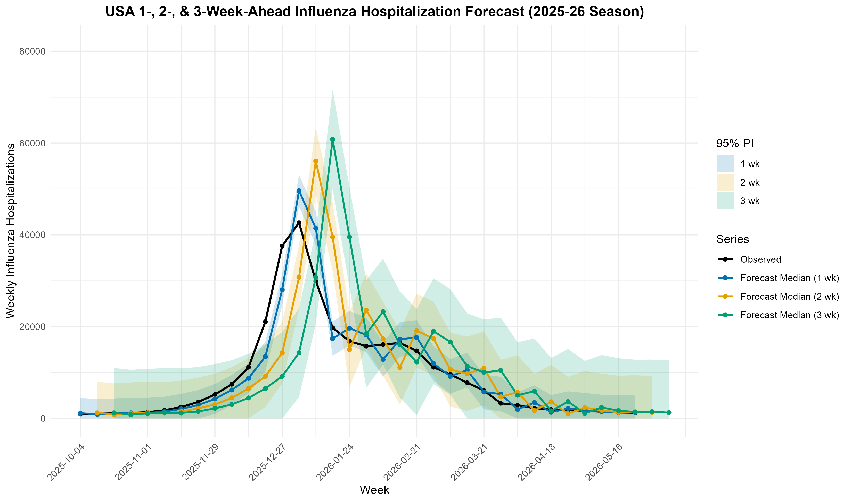

Slide 64
Updating the Quantiles
Now that we have updated our forecasting horizons, we now need to update our pipeline to capture all 23 quantiles
For this exercise, we will be using AI to help us update the rules to get exactly what we want.
 | Current | Goal
Quantiles | 0.025, 0.5, 0.975 | 0.01, 0.025, 0.05, 0.1, 0.15, 0.2, 0.25, 0.3, 0.35, 0.4, 0.45, 0.5, 0.55, 0.6, 0.65, 0.7, 0.75, 0.8, 0.85, 0.9, 0.95, 0.975, and 0.99

Slide 65
Writing the Prompt
We are going to work with AI to help us write the updated rules around adding additional quantiles.
We want to make sure we are explicit about the changes we want and review ALL changes it suggests.
Prompt: Updating the Quantiles
Now I want to update the quantiles we are forecasting. Please expand our forecasts and data files to capture the following quantiles (see attached). Please update the rules document to start.
Then, update the agents.md and 03_forecast.R.

Slide 66
Writing the Prompt
Final Part of Prompt: Validations
Please also include the following data checks:
Validations: For each reference date and horizon, confirm the quantiles are non-decreasing across every level: 0.01 ≤ 0.025 ≤ … ≤ 0.975 ≤ 0.99. Print "[val] quantiles non-decreasing: OK"; stop() otherwise.
Validations: Confirm every reference-date/horizon has the exact required set of quantile levels — none missing, none extra. Print "[val] all quantile levels present: OK"; stop() otherwise.
Validations: Confirm the median (0.5) equals the point forecast and symmetric pairs are equidistant from it (e.g. 0.025 and 0.975). Print "[val] median centered, quantiles symmetric: OK"; stop() otherwise.

Slide 67
